Slide 1
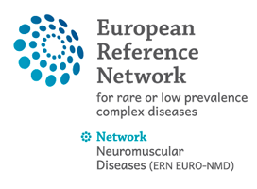
"GENETICKÁ" TERAPIE SMA A DMD
MUDr. Ondřej Havlín, Klinika dětské neurologie LF MU a FN Brno

Slide 2
"A diagnosis of SMA is devastating, leaving untreated babies who have the most severe form with painfully short, highly medicalized lives, during which they are unable to lift their heads, sit or roll, have difficulty swallowing and breathing and need 24-hour care." Jerry Mendell, M.D.

Slide 4
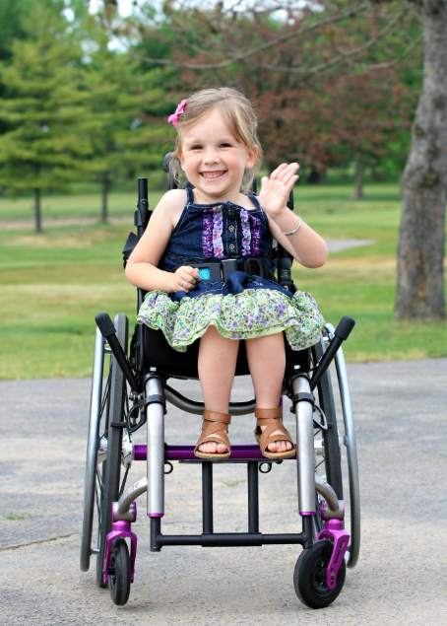

Slide 9
ASO
>
>

Slide 10
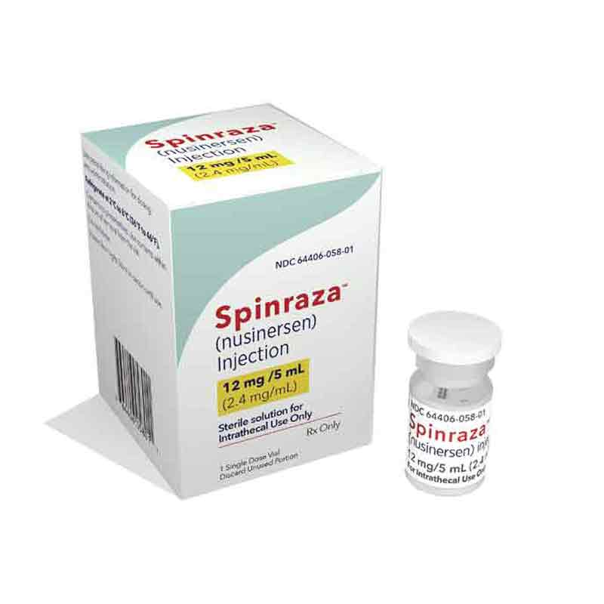
TIME IS MOTOR NEURON

Slide 11
NURTURE clinical trial
100% survival w/o permanent ventilation at 24 mo
88% walking independently at 24 mo
novorozenecký screening!
https://www.nmd-journal.com/article/S0960-8966(19)30906-X/fulltext

Slide 12
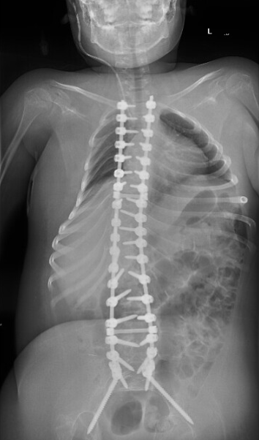
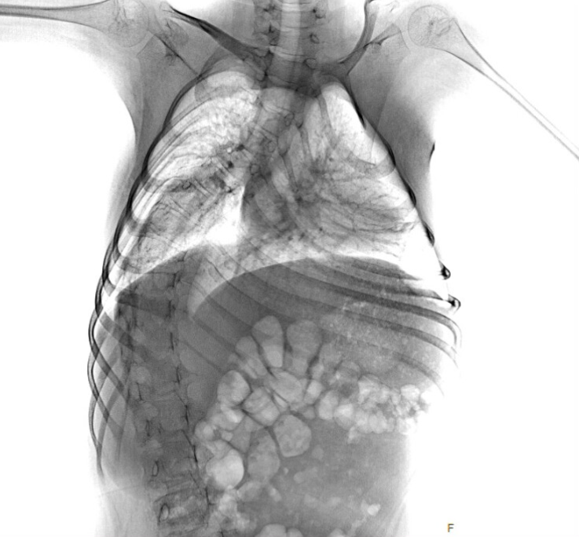

Slide 13
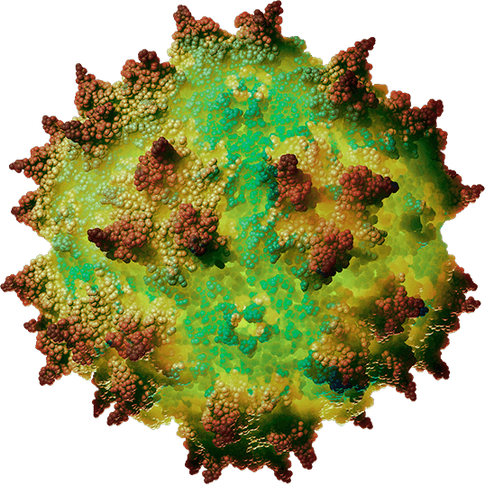

Slide 14
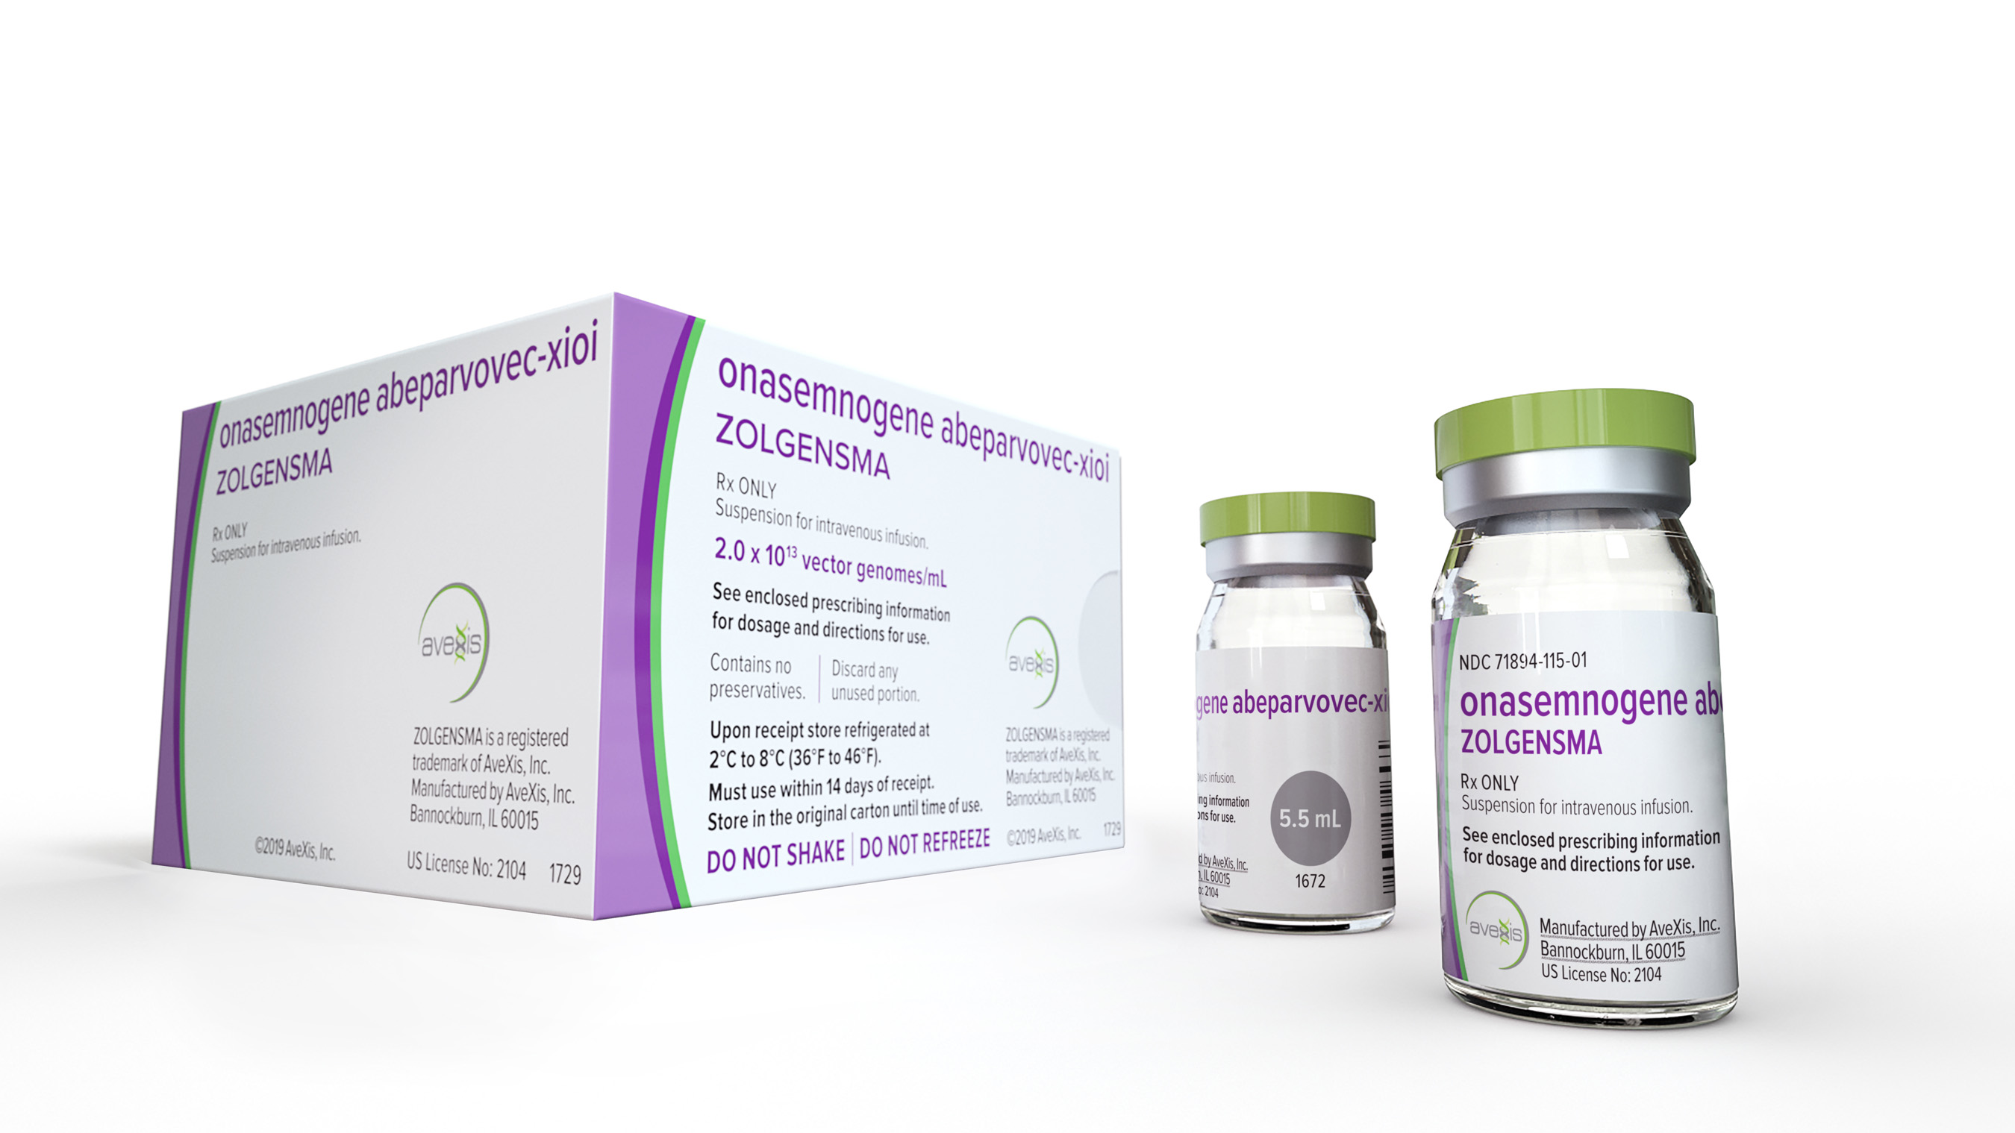

Slide 15
"Duchenne muscular dystrophy (DMD) is a rare but devastating genetic disorder that causes muscle loss and physical impairments. Without dystrophin, muscle cells become weaker and eventually die. Many children lose the ability to walk, and muscles essential for breathing and heart function ultimately stop working."

Slide 16
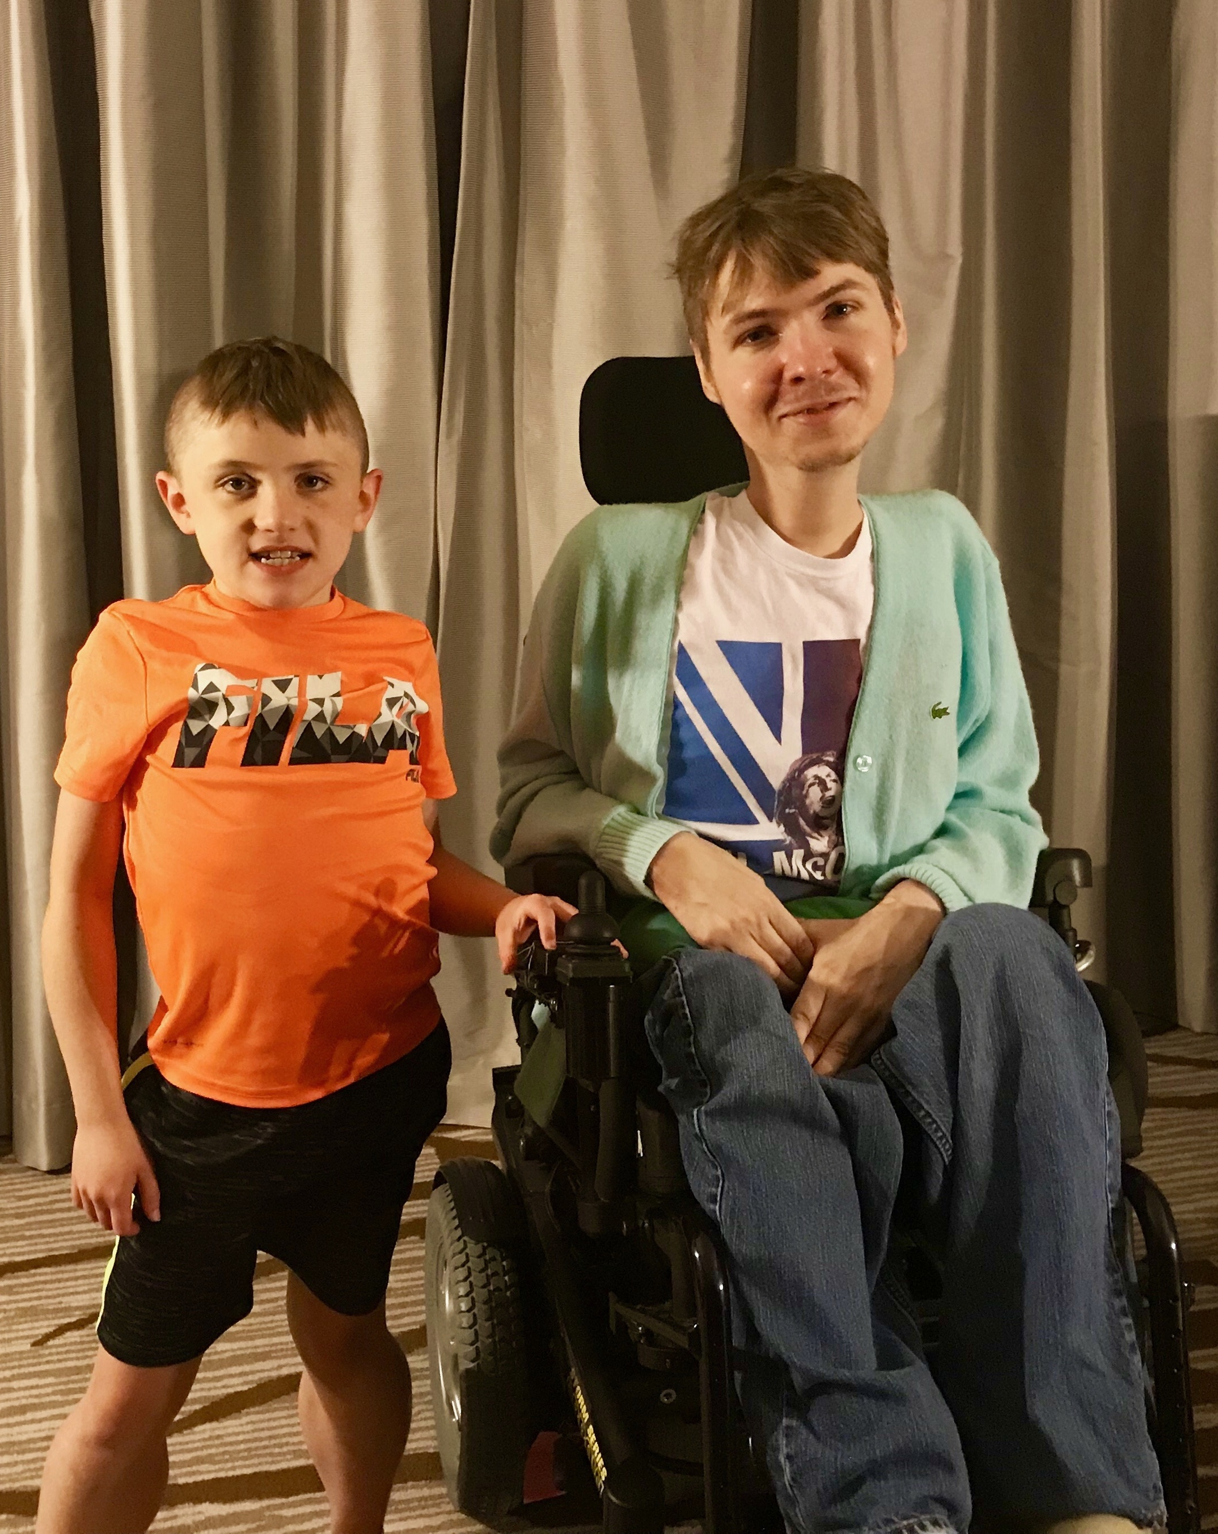

Slide 17
DYSTROFIN
"shock absorber"
spojka cytoskeletálního aktinu se svalovou membránou a extracelulární matrix

Slide 18
vývoj nových terapeutik komplikovaný velmi variabilním genotypem
určení přesného genotypu je kruciální pro dostupnost mutačně-specifických terapií
bodová mutace x delece x duplikace

Slide 19
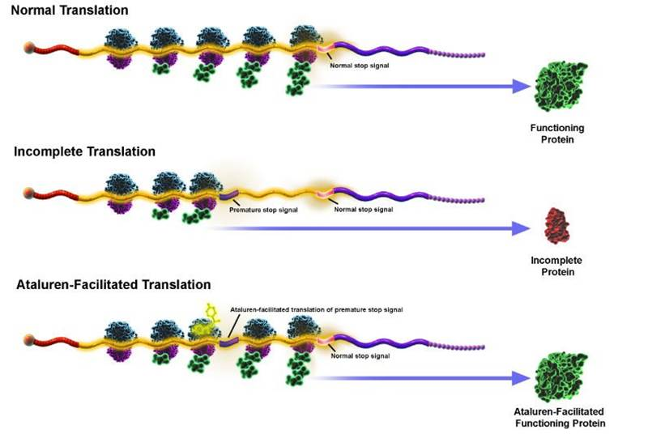

Slide 20
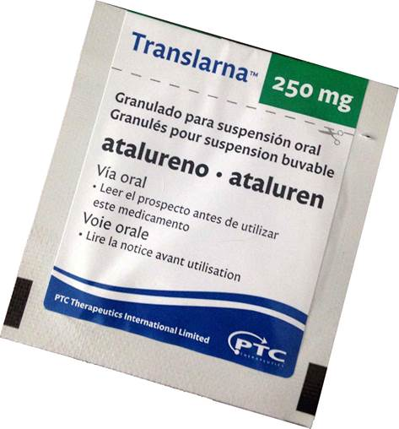

Slide 22
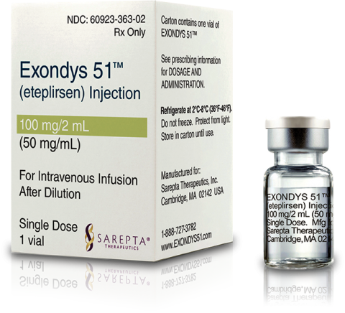
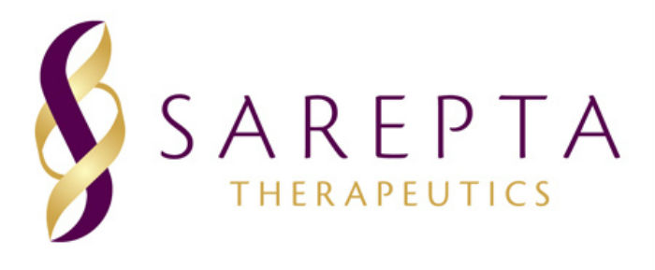

Slide 23
AAV-terapie (micro-dystrofin)
GALGT2 (Sarepta)
SRP-9001 (Sarepta)
SGT-001 (Solid Biosciences)
PF-06939926 (Pfizer)

